Slide 1
Software Project Management
(1)
Du Yugen
ygdu@sei.ecnu.edu.cn
Roger Du@SEI of ECNU

Slide 2

CONTENT
Chapter 1 Introduction to Software Project Management
Chapter 2 Step Wise: An Overview of Project Planning
Chapter 3 Project Evaluation
Chapter 4 Selection of An Appropriate Project Approach
Chapter 5 Software Effort Estimation
Roger Du@SEI of ECNU

Slide 3
CONTENT(cont.)
Chapter 6 Activity Planning
Chapter 7 Risk Management
Chapter 8 Resource Allocation
Chapter 9 Monitoring and Control
Chapter 10 Managing People and Organizing Teams
Chapter 11 Software Quality
Roger Du@SEI of ECNU

Slide 4
References
Recommended reading
  “Software Project Management”, Bob Hughes & Mike Cotterell
  “Rapid Development”, Steve McConnell
  “Information Technology Project Management”, Kathy Schwalbe
  “Quality Software Project Management”, D. Shafer
  “Software Project Survival Guide”, Steve McConnell
  “Peopleware”, T. DeMarco and T. Lister
中文参考资料——
1.PMI：《项目管理知识体系指南》（2013版）（中文版）
2.张家浩主编.软件项目管理.机械工业出版社,2004年6月
3.白思俊主编.现代项目管理（上中下）.机械工业出版社
Roger Du@SEI of ECNU

Slide 5
Score
Final-exam
Project work
Others, presence
Roger Du@SEI of ECNU

Slide 6
Chapter 1
Introduction to Software Project Management
Roger Du@SEI of ECNU

Slide 7
Objectives
When you have completed this chapter, you’ll be able to:
Define the scope of ‘software project management’;
Distinguish between software and other types of development project;
Define the usual stages of a software project;
Explain the main elements of the role of management;
Understand the need for careful planning, monitoring and control;
Identify the stakeholders of a project, their objectives and ways of measuring the success in meeting those objectives;
Measure the success of a project in meeting its objectives.
Roger Du@SEI of ECNU

Slide 8
1.1 What’s a project?
A project is a temporary endeavor undertaken to create a unique product, service or result (PMI definition). Temporary means that every project has a definite beginning and a definite end. Unique means that the product or service is different in some distinguishing way from all similar products or services.
Roger Du@SEI of ECNU

Slide 9
Key characteristics of a project
Non-routine tasks are involved;
Planning is required;
Specific objectives are to be met or a specified product is to be created;
The project has a predetermined time span (which may be absolute or relative);
Work involves several specialisms;
Work is carried out in several phrases;
The resources that are available for use on the project are constrained;
The project is large or complex.
Roger Du@SEI of ECNU
Notes:
􀂊 项目是什么
􀂄 非常规的任务
􀂄 需要计划
􀂄要满足特定的目标需要或者创建特定的产品
􀂄 项目有一个预定的时间范围
􀂄是为他人工作,不是为自己
􀂄 工作涉及几个学科
􀂄 工作分为若干阶段进行
􀂄 可用的项目资源是受到限制的确
􀂄 项目是大型的或者复杂的

Slide 10
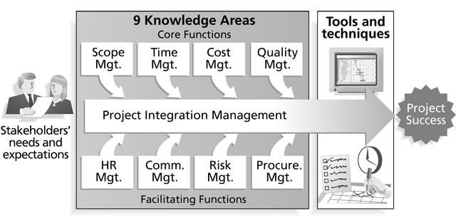
PMI’s 9 Knowledge Areas
Source: Project Management Institute
Roger Du@SEI of ECNU
Notes:
Project integration management
Scope
Time
Cost
Quality
Human resource
Communications
Risk
Procurement

Slide 11
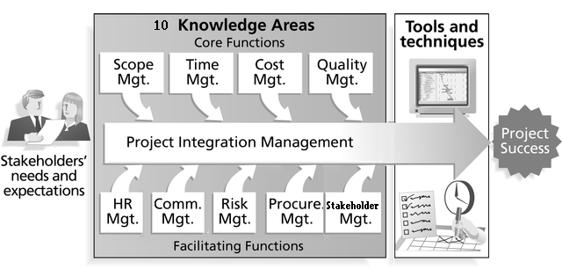
PMI’s 10 Knowledge Areas
Roger Du@SEI of ECNU

Slide 12
Ex 1.1 order the followings by closely matching a project
Producing an edition of a newspaper;
Building the Channel Tunnel;
Getting married;
Amending a financial computer system to deal with dates after 31st Dec., 1999;
a research project into what makes a good human-computer interface;
an investigation into the reason why a user has a problem with a computer system;
A programming assignment for student;
Writing an OS for a new computer;
Installing a new version of a word processing application.
Roger Du@SEI of ECNU
Notes:
考虑下面事情哪些更像一个项目
􀂄 出版一份报纸
􀂄 造一个跨海隧道
􀂄 结婚
􀂄 为金融部门的计算机系统处理2000年问题
􀂄 对什么是好的人机接口形式的研究
􀂄 对用户使用计算机系统出现问题的调查
􀂄 为一个新计算机写一个操作系统
􀂄 为一个机构安装新的文字处理软件包版本

Slide 13
1.2 Characteristics of software project
products of software projects have certain characteristics which make them different.
  Invisibility: with software, progress is not immediately visible.
  Complexity: it’s more complex how to spend per dollar on software products than on other engineered artefacts.
  Conformity: Software developers have to conform to the requirements of human clients.
  Flexibility: software can be easily changed to accommodate the physical or organizational system.
Roger Du@SEI of ECNU

Slide 14
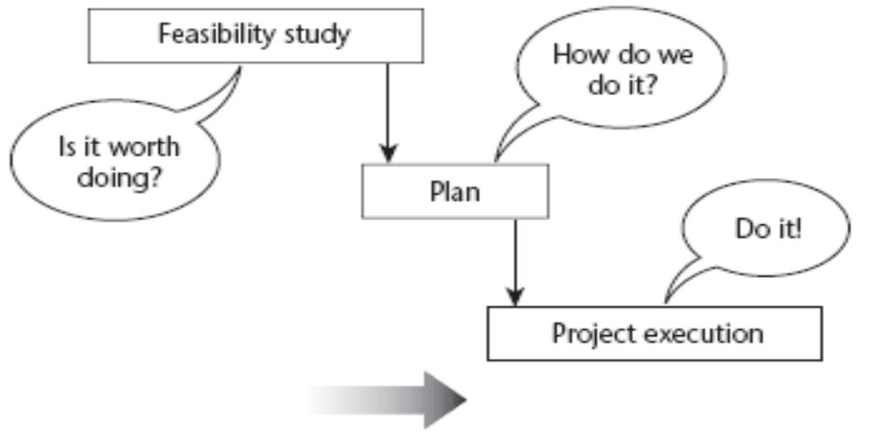
1.3 activities covered by SPM
A feasibility study
Planning
Project executing
Roger Du@SEI of ECNU

Slide 15
Project vs. Programme
What’s a ‘programme’?
  Mostly differences of scale
  Often a number of related projects
  Longer than projects
  Definitions vary
Ex: Programme Manager for MS Word
Note:Programme可以译为项目群,一组相关的项目
Roger Du@SEI of ECNU
Notes:
Programme可以译为项目群

Slide 16
1.4 Project Phases项目阶段
All projects are divided into phases
All phases together are known as the Project Life Cycle
Each phase is marked by completion of Deliverables
Identify the primary software project phases
Notes:每一个项目阶段的标记是一个或几个可交付的物件(deliverable)。Deliverable是一个具体的可验证的工作产品，如可行性研究，详细设计或者一个工作原型。
项目阶段的结束是由关键交付物或者项目性能作标记的，以确定项目是否能够继续进行下一阶段或者检测和修正错误。阶段结束的检查经常被称为phase exits, stage gates, kill points.
Roger Du@SEI of ECNU

Slide 17
1.4 Project Phases(cont.)
Initiate
Plan
Control
Execute
Close
PROJECT PHRASE
Roger Du@SEI of ECNU

Slide 18
①启动阶段及其核心工作
完成工作量
时间
C D E F
C—启动阶段
风险分析
拟订战略方案
进行资源测算
提出组建项目组方案
提出项目建议书
获准进入下一阶段
明确需求、策划项目
调查研究、收集数据
确立目标
进行可行性研究
明确合作关系
Roger Du@SEI of ECNU

Slide 19
项目阶段与项目任务
（1）项目启动
当用户有需求的时候，潜在的项目就产生了。软件开发商在这个阶段的主要任务是确认需求，在如果我们要做这个项目的假设下，分析投资收益比，研究项目的可行性，分析自己所应具备的条件。商务上这个阶段以客户提出（常常是厂商提出、由用户认可）明确的《需求建议书》或《招标书》为结束标志。这个阶段是厂商与客户配合完成的，如果客户能积极地配合厂商（这是最后中标的良好前兆），则对后期项目的成功非常有利：一方面，可以比较明确地搞清项目范围、项目目标，了解客户真正需要什么。另一方面早期的交流可建立良好客户关系，为后续的投标、合同签订，乃至项目实施奠定基础。
Roger Du@SEI of ECNU

Slide 20
②计划阶段及其核心工作
完成工作量
时间
D —计划阶段
确定项目组主要成员
项目最终产品的范围确定
实施方案研究
项目质量标准的确定
项目的资源保证
项目的环境保证
主计划的制订
项目经费及现金流量的预算
项目的工作结构分解（WBS）
项目政策与过程的制订
风险评估
确认项目有效性
提出项目概要报告
获准进入下一阶段
Roger Du@SEI of ECNU

Slide 21
项目阶段与项目任务
（2）项目计划
如果厂商向客户提交了《项目建议书》，介绍了解决方案，进入了入围厂家名单，开始等着招标，这就是上一个阶段工作基本成功的标志。也是能赢得项目的关键。接下来的工作，从商务上，就是竟标，如果中标后，签订商务合同的工作。公司既要展示实力又要合理报价。如果竞标成功则签订合同，厂商开始承担项目成败的责任。
根据一般项目管理经验，这个时候，公司可以开始成立项目组，确定项目经理。把项目前期的工作部门，从销售和市场部门，逐步转到专门为这个项目目标而成立的项目组身上。从公司角度来看，这才是项目的开始。
新的项目经理马上要着手开展的工作，就是为项目制订项目计划、核算成本等。
Roger Du@SEI of ECNU

Slide 22
③实施阶段及其核心工作
完成工作量
时间
C D E F
E —实施阶段
建立项目组织
建立与完善项目联络渠道
实施项目激励机制
建立项目信息控制系统
建立项目工作包，细化各项技术需求
执行WBS的各项工作
获得订购物品及服务
指导/监督/预测/控制：范围、质量、进度、成本
解决实施中的问题
Roger Du@SEI of ECNU

Slide 23
项目阶段与项目任务
（3）项目执行
合同签订，进入了正式的项目实施阶段，项目经理需要细化目标，制定工作计划，协调人力和其他资源；定期监控进展，分析项目偏差，采取必要措施以实现目标。因为IT项目的不确定性，项目监控显得非常重要，特别是有众多项目同时运行的IT公司，必须建立公司一级的监控体系跟踪项目的运行状态。
Roger Du@SEI of ECNU

Slide 24
④结束阶段及其核心工作
完成工作量
时间
C D E F
F—结束阶段
最终产品的完成
评估与验收
清算最后帐务
项目评估
文档总结
资源清理
转换产品责任者
解散项目组
Roger Du@SEI of ECNU

Slide 25
项目阶段与项目任务
（4）项目结束
项目结束阶段，项目组要移交工作成果，帮助客户实现商务目标；系统交接给维护人员；结清各种款项。完成这些工作后，一般还应进行项目评估。
Roger Du@SEI of ECNU

Slide 26
1.5 a typical PLC
Requirements
Analysis
Specification
Design
Coding
Verification &
validation
Implementation
/installation
Maintenance
& support
Roger Du@SEI of ECNU

Slide 27
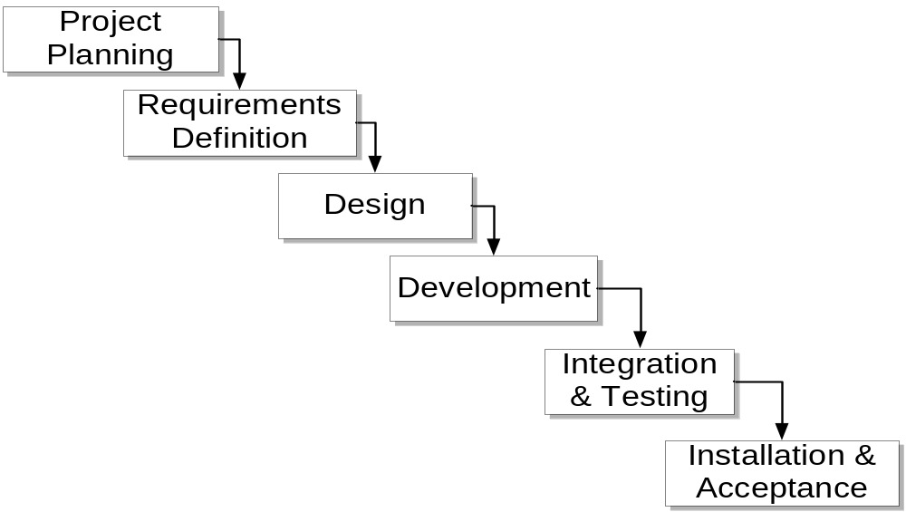
The SDLC waterfall
Small to medium database software projects are generally broken down into six stages:
Roger Du@SEI of ECNU

Slide 28
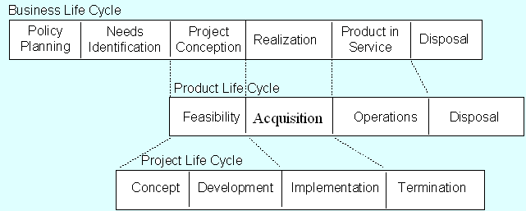
Lifecycle Relationships
Roger Du@SEI of ECNU

Slide 29
Ex 1.2
Brightmouth学院原来属于政府管辖，现在独立办学，但是工资单仍然由政府的计算机中心生成，而政府对这一服务进行收费。因而学校考虑是否自行采用一个现成的系统来管理这些数据。该项目包含哪些阶段？
项目评估，计划，需求描述，设计/编码，验证
Roger Du@SEI of ECNU

Slide 30
1.6 some way of categorizing software projects
Information system vs embedded system
  IS interfaces with organization
e.g. a stock control system
  ES interfaces with hardware
e.g. a system which controls AC in a building
Roger Du@SEI of ECNU

Slide 31
Ex 1.3
Would an OS on a computer be an IS or ES?
Roger Du@SEI of ECNU

Slide 32
1.6 some way of categorizing software projects (cont.)
Objectives vs products
  Projects may be distinguished by whether their aim is to produce a product or to meet certain objectives.
  Many software projects have two stages. The first stage is an objectives-driven project . The next stage is a project actually to create the software product.
Roger Du@SEI of ECNU

Slide 33
Ex 1.4
Brightmouth推行的独立的工资系统是一个目标驱动(objectives-driven)的项目还是一个产品驱动(product-driven)的项目？
Roger Du@SEI of ECNU

Slide 34
1.7 the project as a system
Systems, subsystem, environments
  A system is a set of interrelated parts.
  A system will be a subsystem of a large system.
  Outside the system there will be the system’s environment.
Roger Du@SEI of ECNU

Slide 35
1.7 the project as a system(cont.)
Open vs closed systems
Open systems interact with the environment. Nearly all systems are open
Socio-technical systems
Software projects belong this category of systems
Roger Du@SEI of ECNU

Slide 36
1.8 what is SP management?
SP management involves activities:
Planning-deciding what is to done;
Organizing-making arrangement;
Staffing-selecting the right people;
Directing-giving instructions;
Monitoring-checking on progress;
Controlling-taking action to remedy hold-ups(障碍);
Innovating-coming up with new solution;
Representing-liaising with users etc.
Roger Du@SEI of ECNU

Slide 37
Software Project Management
Project management is the application of knowledge, skills, tools, and techniques
to project activities in order to meet or exceed stakeholder needs and expectations
from a project.
Management
Project
Management
Software
Project
Management
Roger Du@SEI of ECNU

Slide 38
Ex 1.5 management responsibilities
Paul Duggan is the manager of a software development section. On Tuesday at 10.00 am he and his fellow section heads have a meeting with their group manager about the staffing requirements for the coming year. Paul has already drafted a document ‘bidding’ for staff. This is based on the work planned for his section for the next year. The document is discussed at the meeting. At 2.00 pm Paul has a meeting with his senior staff about an important project his section is undertaking. One of the programming staff has just had a road accident and will be in hospital for some time. It is decided that the project can be kept on schedule by transferring another team member from less urgent work to this project. A temporary replacement is to be brought in to do the less urgent work, but this may take a week or so to arrange. Paul has to phone both the personnel manager about getting a replacement and the user for whom the less urgent work is being done explaining why it is likely to be delayed.
Identify which of the eight management responsibilities listed above Paul was responding to at different points during his day.
Roger Du@SEI of ECNU

Slide 39
1.9 problems with software projects
从项目经理的观点看：
  较差的评估和计划
  缺乏质量标准和度量
  缺乏组织决策的指南
  缺乏使进度可视化的技术
  较差角色定义(谁做什么)
  不正确的成功准则
Roger Du@SEI of ECNU

Slide 40
1.9 problems with software projects (cont.)
从项目成员观点看：
  工作的不正确的描述
  IT的管理失误
  缺少应用领域的知识
  缺少及时的文档
  前续任务没有及时完成——包括设备没有及时提供
  用户与技术员之间缺乏交流
  缺少质量控制
  软件环境的改变
  Deadline压力
Roger Du@SEI of ECNU

Slide 41
1.9 problems with software projects (cont.)
What about the problems faced by the customers
The US Internal Revenue System was to abandon its tax system modernization programme after having spent $4 billion.
The state of California spent $1 billion on its non-functional welfare database system.
The £339 million UK air traffic control system was reported as being two years behind schedule.
A discount stock brokerage company had 50 people working 14 hours or more a day to correct clerically three months of records – the report commented that the new system had been rushed into operation without adequate testing.
In the United Kingdom, a Home Office immigration service computerization project was reported as having missed two deadlines and was nine months late.
The Public Accounts Committee of the House of Commons in the United Kingdom blamed software bugs and management errors for £12 million of project costs in relation to an implementation of a Ministry of Agriculture computer system to administer farm subsidies.
Roger Du@SEI of ECNU

Slide 42
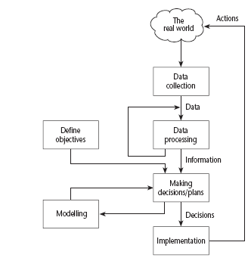
1.10 management control
Project control cycle
Roger Du@SEI of ECNU

Slide 43
1.11 project objective
目标：项目的目标必须清晰定义，以确定成功的关键。
每一个项目必须有一个项目权威（authority）,该权威经常由项目指导委员会(steering committee)或项目管理委员会(project board)担任,项目的目标必须由指导委员会确定。
子目标：
  objectives will need to be broken down into goals or sub-objectives.
效率的测量：有效的目标必须易于测量，从而更能够衡量是否成功。如“减少客户抱怨50％”将比“改善客户关系”更容易测量。
Roger Du@SEI of ECNU

Slide 44
Ex 1.6
Identify the objectives and sub-objectives of the Brightmouth College payroll project.What measures of effectiveness could be used to check the success in achieving the objectives of the project?
识别Brightmouth工资系统的目标和子目标，检验成功的标准是什么？
如在什么日期前实施工资处理系统，实现系统所需要的功能，在一定的成本范围内
Roger Du@SEI of ECNU

Slide 45
1.12 stakeholders
Internal to the project team This means that they will be under the direct managerial control of the project leader.
External to the project team but within the same organization For example, the project leader might need the assistance of the information management group in order to add some additional data types to a database or the assistance of the users to carry out systems testing. Here the commitment of the people involved has to be negotiated.
External to both the project team and the organization External stakeholders may be customers (or users) who will benefit from the system that the project implements or contractors who will carry out work for the project. One feature of the relationship with these people is that it is likely to be based on a legally binding contract.
  e.g. Project sponsor, Executives, Team, Contractors, Functional managers, Customers
Roger Du@SEI of ECNU
Notes:
涉众/项目相关者/干系人(stakeholders)
􀂄 项目小组内部：
􀂄 项目小组外部，但是在同一组织内：
􀂄 项目小组和组织外部：如客户
􀂊 不同的项目相关者有不同的目标，因而项目领导
者需要能够协调这些目标。Boehm和Ross提出软
件项目管理的“W理论”，该理论关注于所有各方
都能从项目种获益因而对项目的成功都有兴趣。
（W代表Everyone是 a Winner）
􀂊 练习：识别工资系统的项目影响者

Slide 46
Ex 1.7
Identify the stakeholders in the Brightmouth College payroll project.
Roger Du@SEI of ECNU

Slide 47
1.13 requirement specification
Functional requirements These define what the end-product of the project is to do. Systems analysis and design methods, such as SADT and Information Engineering, are designed primarily to provide functional requirements.
Quality requirements There will be other attributes of the application to be implemented that do not relate so much to what the system is to do but how it is to do it. These are still things that the user will be able to experience. They include, for example, response time, the ease of using the system and its reliability.
Resource requirements A record of how much the organization is willing to spend on the system. There may be a trade-off between this and the time it takes to implement the system. In general it costs disproportionately more to implement a system by an earlier date than a later one. There may also be a trade-off between the functional and quality requirements and cost. We would all like exceptionally reliable and user-friendly systems which do exactly what we want but we may not be able to afford them.
Roger Du@SEI of ECNU

Slide 48
1.14 conclusion
Projects are by definition non-routine and therefore more uncertain than normal undertakings.
Software projects are similar to other projects, but have some attributes that present particular difficulties, e.g. the relative invisibility of many of their products.
A key factor in project success is having clear objectives. Different stakeholders in a project, however, are likely to have different objectives. This points to the need for a recognized overall project authority.
For objectives to be effective there must be practical ways of testing that the objectives have been met.
Where projects involve many different people, effective channels of information have to be established. Having objective measures of success helps unambiguous communication between the various parties to a project.
Roger Du@SEI of ECNU

